Slide 1

Modelling Climate Uncertainty
Dr.
f.venmans1@lse.ac.uk
Lent term 2023

Slide 2
Overview
Local methods, linearizing the solution around the steady state are popular in macroeconomics. They allow for many state variables.
We will see 5 global methods of solving climate models, all based on dynamic programming
System of differential equation as Boundary Value Problem (Matlab)
System of differential equations with closed form solution (WolframAlpha)
Excel solver (similar to DICE in GAMS and fmincon in Matlab)
Open loop models or SCC on non-optimal paths
Recursive models, collocation method with polynomials and Value function iteration.
I also want to give intuition and general insights from Integrated Assessment Models
Climate dynamics
Marginal abatement costs
Damage functions
Sensitivity analysis on DICE, stranded assets, technological change, stranding of fossil reserves

Slide 3
Further literature
Dixit & Pindyck 1994 Investment under uncertainty, Princeton University Press
Miranda & Fackler 2002 Applied computational economics and finance, MIT
Judd 1998 Numerical Methods in EconomicsComputational economics, MIT
Villaverde, Ramirez, Schorfheide, 2020 Solution and Estimation methods for DSGE models. Chapter 9 Handbook of Macroeconomics
Scheidegger See articles on neural networks.

Slide 4
Climate dynamics

Slide 5
Warming is proportional to cumulative emissions
Dietz, van der Ploeg, Rezai, Venmans 2021.
According to the leading science models, a pulse of emissions has a peak effect within the first decade. There is very little uncertainty about this rapid reaction.
Thereafter, the warming effect is constant over many centuries. This is due to the interaction between the carbon absorption and thermal inertia
In the first decades, most of the CO2 is still in the atmosphere (high flow of incoming energy), but it takes time to warm up (think of the thermal inertia of a pot of soup which warms slowly if you put a lighter below it)
After a century, 50% of the CO2 is absorbed (less incoming energy), but the earth has had time to absorb the incoming extra energy.
Moreover, the impact response function today is very similar to the one in a hotter future because in the warmer future:
At high atmospheric CO2 concentrations, extra CO2 has less effect on forcing (saturation of wavelengths)
More acid and warmer oceans absorb CO2 slower, leaving it for longer in the atmosphere. (saturation of carbon sinks)

Slide 6
Temperature effect of a pulse of emissions
All 256 combinations of the science models in the CMIP5 modelling ensemble.
Pulse of 100 GtC in 2005

Slide 7
Temperature effect of a pulse of emissions
Most economic models show too much delay between emissions and warming
Approximation for a model where temperature is linear in cumulative emissions.

Slide 8

6th IPCC report
$$\dot{T}=ζE$$

Slide 9
Marginal abatement costs curves and damage functions

Slide 10
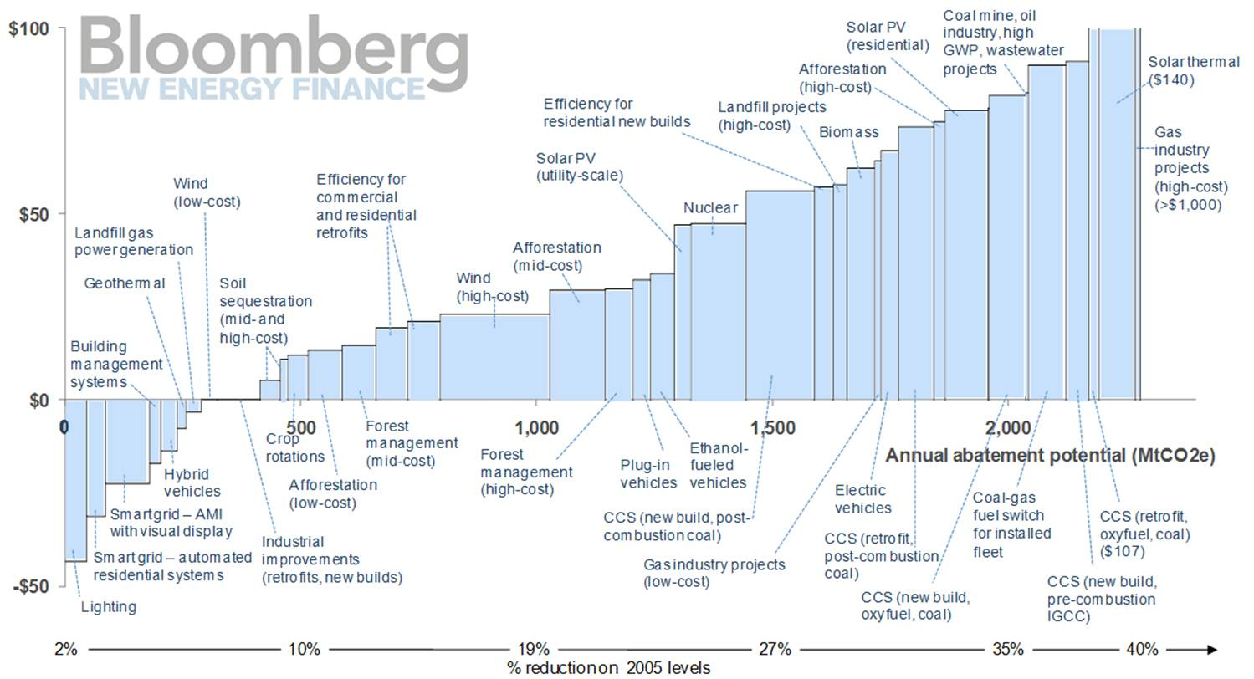
Marginal abatement costs for the USA in 2030
Bloomberg 2011. Abatement opportunities in USA in 2030, under optimal technology stimulus

Slide 11
Marginal abatement costs for hydrogen in 2050
Bloomberg Hydrogen Economy Outlook (2020). Optimistic scenario for 2050.

Slide 12
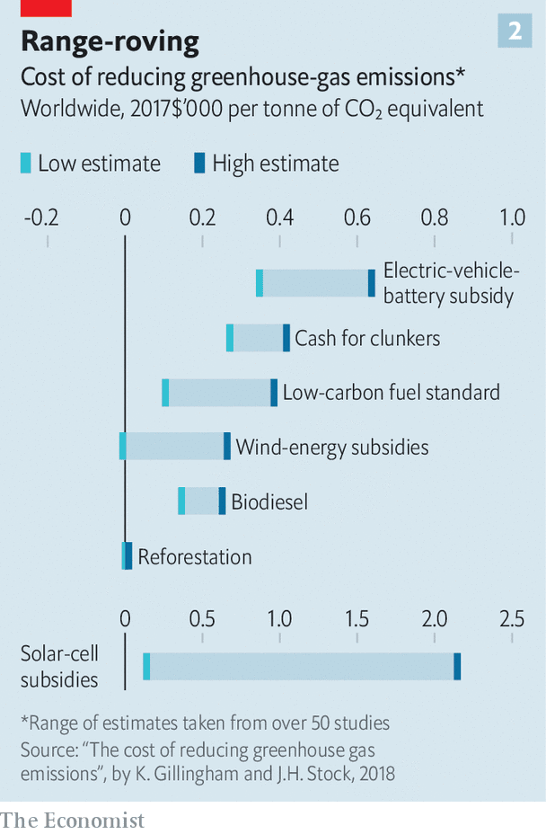
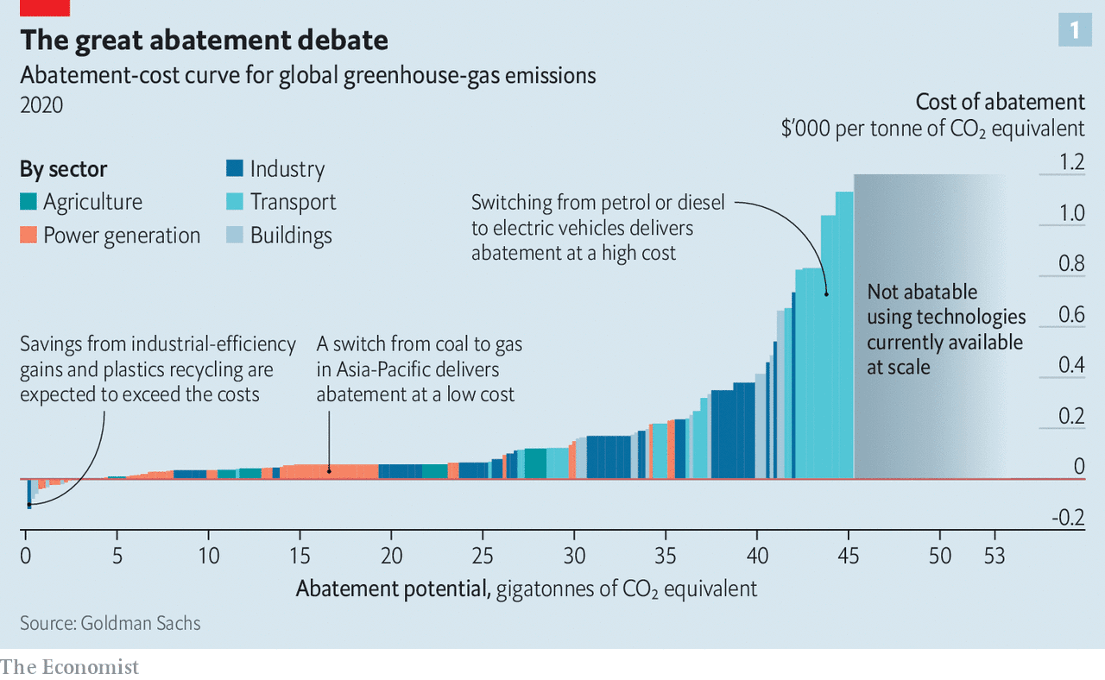

Slide 13
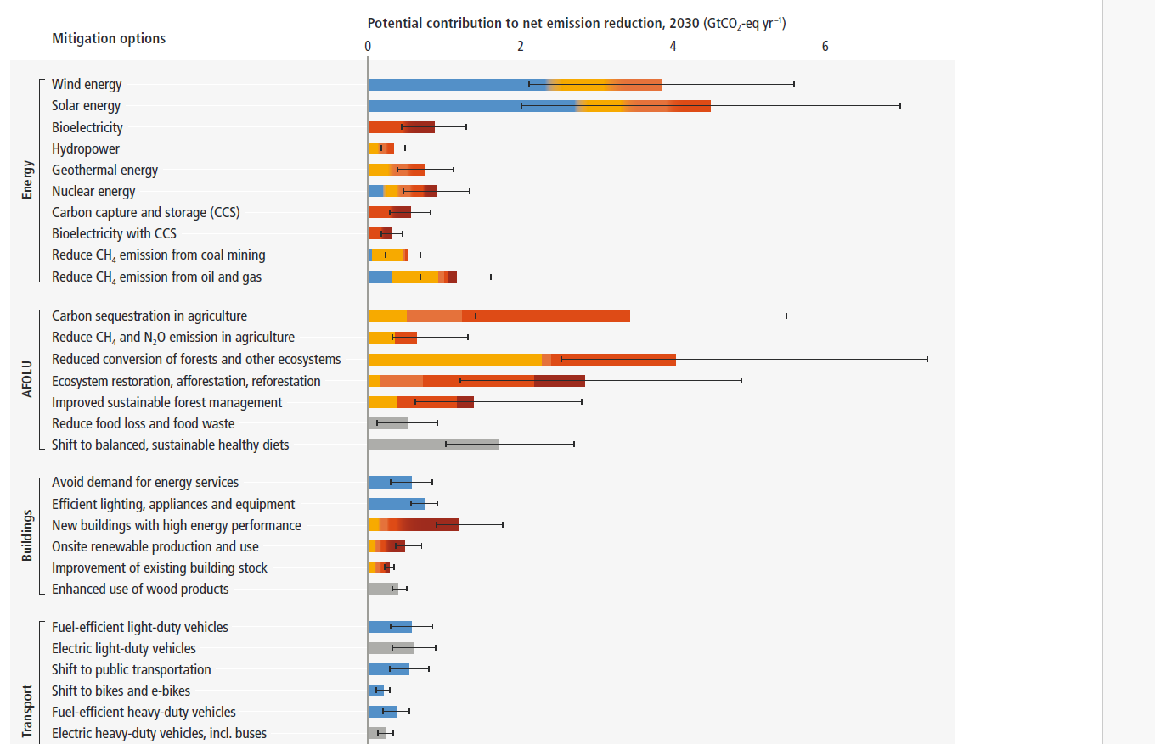

Slide 14
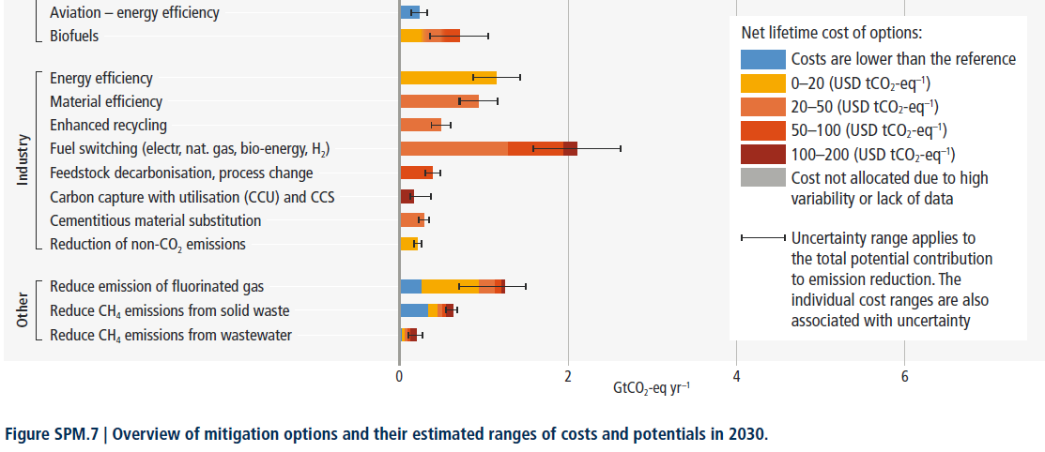

Slide 15
Damage functions (Howard & Sterner 2017)
Burke, Hsiang, Miguel 2015 Nature. Econometric example with very high damages.

Slide 16
Dynamic programming in 2 slides

Slide 17

Dynamic optimization: Bellman equation
Consider a welfare function in discontinuous time
$$V_{0}\left(k_{0}\right)=\max_{c_{0},c_{1},c_{2}…}{\sum_{0}^{T}{\frac{1}{{\left(1+δ\right)}^{t}}{u(c}_{t},k_{t})}}=\max_{c_{0},c_{1},c_{2}…}\left\{u_{0}+\underset{\frac{1}{1+δ}V_{1}}{\underbrace{\frac{1}{1+δ}u_{1}+\frac{1}{{\left(1+δ\right)}^{2}}u_{2}… }}\right\}$$
$$s.t. k_{t+1}−k_{t}=G(c_{t},k_{t})$$
The value function does not depend on consumption, since consumption will be optimized.
Writing the same equation for time 1 and substituting, we have
$$V_{0}\left(k_{0}\right)=\max_{c_{0}}\left\{u\left(c_{0},k_{0}\right)+\frac{1}{1+δ}V_{1}(k_{1})\right\}$$
Writing this equation of any time t gives the Bellman equation
$$V_{t}\left(k_{t}\right)=\max_{c_{t}}\left\{u\left(c_{t},k_{t}\right)+\frac{1}{1+δ}V_{t+1}(k_{t+1})\right\};V_{T}(k_{T})=\max_{c_{T}} u_{T}$$
Bellman’s principle: An optimal policy has the property that, whatever the initial action, the remaining choices constitute an optimal policy with respect to the subproblem starting at the state that results from the initial actions.
Notes:
The Value function expressed in its current value.

Slide 18

Hamilton, Jacobi, Bellman equation
Bellman equation for time interval $Δt$:
$$V_{t}\left(k_{t}\right)=\max_{c_{t}}\left\{u\left(c_{t},k_{t}\right)Δt+\frac{1}{1+δΔt}V_{t+Δt}(k_{t+Δt})\right\}$$
Multiply by $(1+δΔt)$ and rearrange:
$$δΔtV_{t}\left(k_{t}\right)=\max_{c_{t}}\left\{u\left(c_{t},k_{t}\right)Δt(1+δΔt)+V_{t+Δt}\left(k_{t+Δt}\right)−V_{t}\left(k_{t}\right)\right\}$$
Divide by $Δt$and let it go to zero. This results in the HJB equation
$$δV\left(k_{t}\right)=\max_{c_{t}}\left\{u\left(c_{t},k_{t}\right)+\frac{d}{dt}V(k_{t})\right\}$$
If there is uncertainty, maximizing expected utilities, yields by the same reasoning
$$δV\left(k_{t}\right)=\max_{c_{t}}\left\{u\left(c_{t},k_{t}\right)+\frac{1}{dt}𝔼\left[dV\left(k_{t}\right)\right]\right\}$$
If the equation of motion contains a Brownian motion or Jump, apply Ito’s Lemma to dV. (Dixit & Pindyck, Investment under uncertainty)
Notes:
V in the slide represents the current value Value Function. Define the present value Value Function $V^{PV}=e^{−δt}{ V}^{CV}$. Differentiate wrt to time gives $\frac{{dV}^{PV}}{dt}=e^{−δt}\frac{{ dV}^{CV}}{dt}−δe^{−δt}V^{CV}$.
Substitute in the Bellman equation gives
$$0=\max_{c_{t}}\left\{u\left(c_{t},k_{t}\right)+e^{δt}\frac{1}{dt}𝔼\left[dV^{PV}\left(k_{t}\right)\right]\right\}$$
Check the exponential factor, shouldn’t be there.

Slide 19
The simplest climate model

Slide 20

Abatement costs vs damages
Define cumulative emissions S
$$\dot{S}=E$$
Assume Temperature increases linearly with cumulative emissions
$$T=ζS$$
Consider at total benefit function B(E), expressed in £/tCO2. The marginal benefit of a tonne of emissions is B_{E} , which is by definition also the marginal abatement cost. For example, the marginal productivity from an extra unit of oil equals the marginal cost of substituting the tonne by another input.
Consider a total damage function for a given level of cumulative emissions (and hence temperature) $\tilde{D}\left(T\right)=\tilde{D}\left(ζS\right)=D(S)$. The marginal damage for an extra unit of emission writes D_{S}
Maximize welfare trading off total benefits from emissions and total damages from climate warming
$$V=max\int_{0}^{∞}{e^{−rt}}\left(B\left(E_{t}\right)−D\left(S_{t}\right)\right)dt$$

Slide 21

Solve Bellman equation
Bellman equation
$$rV\left(S\right)=\max_{E_{t}}{\{B\left(E_{t}\right)−D\left(S_{t}\right)+\frac{d}{dt}V(S)\}}$$
With $\frac{d}{dt}V\left(S\right)=V_{S} \dot{S}=V_{S}E$
FOC of maximum
$$B_{E}=−V_{S} (1)$$
Apply the envelope theorem to the Bellman equation (costate eq in optimal control)
$$rV_{S}=−D_{S}+\frac{d}{dt}\left(V_{S}\left(S_{t}\right)\right) (2)$$
Take the time derivative of eq. 1
$$\frac{d}{dt}\left(B_{E}(E_{t})\right)=−\frac{d}{dt}\left(V_{S}\left(S_{t}\right)\right) (3)$$
Substitute out $\frac{d}{dt}(V_{S}\left(S_{t}\right)$ from eq. 2 and 3 gives the Euler Equation
$$B_{EE}\dot{E}=rB_{E}−D_{S}$$
Together with the equation of motion $\dot{S}=E$, we have a system of 2 differential equations for 2 variables (E and S).

Slide 22

Intuition
$V_{S}$ is the shadow price of the stock variable, the increase in the Value function if we start the problem with one unit of stock extra. (It equals the shadow price of optimal control)
Using the integral definition of the value function (and Leibniz rule) eq. 1 becomes
$$\underset{MAC}{\underbrace{B_{E}}}=\underset{SCC}{\underbrace{\int_{t}^{∞}{e^{−r\left(τ−t\right)}D_{S_{τ}}}dt}}$$
Eq. 2 can be written as an optimal growth rate of the SCC :
$$\frac{\dot{V_{S}}}{V_{S}}=r−\frac{D_{S}}{V_{S}}$$
Most IAM’s apply cost-effectiveness, by replacing damages by a temperature constraint. The result is that the MAC raises at the discount rate, i.e. too fast, starting too low. It is always welfare increasing to abate more at the start, and less in the long run.

Slide 23

Boundary Value Problem
The Euler equation and the equation of motion give us a system of 2 differential equations for 2 variables :
$$\dot{E}=\frac{rB_{E}−D_{S}}{B_{EE}}$$
$$\dot{S}=E$$
This can be solved as a boundary value problem using boundaries
$$E_{2200}=0$$
$$S_{0}=\frac{1.2°C}{ζ}$$
Matlab function https://uk.mathworks.com/help/matlab/ref/bvp4c.html

Slide 24
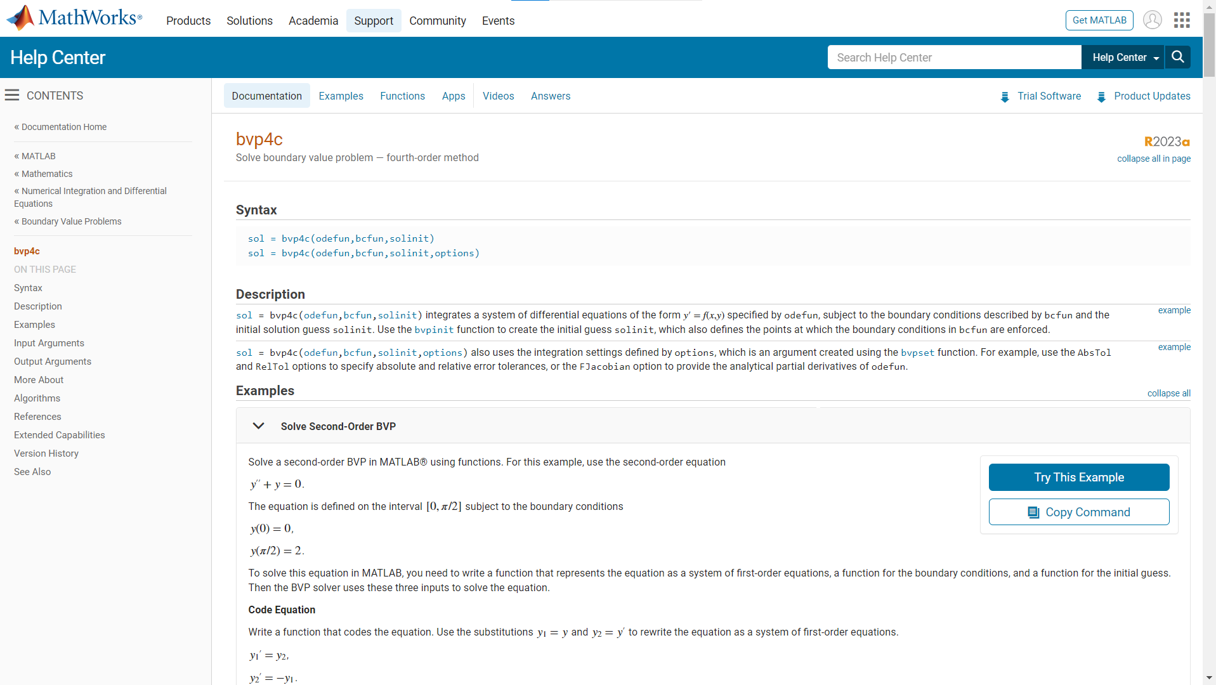

Slide 25

Same solution with optimal control
Current value Hamiltonian
$$ℋ^{CV}=\underset{objective fct}{\underbrace{B\left(E_{t}\right)−D\left(S_{t}\right)}}+\underset{\begin{aligned}shadow \\ price\end{aligned}}{\underbrace{μ}}\underset{\begin{aligned}equation \\ of motion\end{aligned}}{\underbrace{E}}$$
FOC for maximum $\frac{∂ℋ}{∂E}=0$
$$\underset{MAC}{\underbrace{B_{E}}}=−μ (1)$$
The shadow price of emissions equals the present value of the MAC
Costate equation -$\frac{∂ℋ^{CV}}{∂S}=\dot{μ}−rμ$
$$D_{S}=\dot{μ}−rμ (2)$$
Notes:
The optimal MAC increase at a rate lower than the discount rate. Therefore, the current value of MAC increases over time, the present value of MAC decreases over time and $\dot{λ}=−\frac{d}{dt}MAC>0$.

Slide 26

Steady state
Since an emission has an ever-lasting effect, the steady state has zero emissions and a stable climate.
Setting time derivatives to zero in the preceding equation yields the steady state
$$\underset{MAC at zero emissions}{\underbrace{B_{E}}}=\underset{\begin{aligned}ever−lasting marginal damage \\ at steady state temperature \\ =SCC at steady state\end{aligned}}{\underbrace{\frac{D_{S}}{r}}}$$

Slide 27
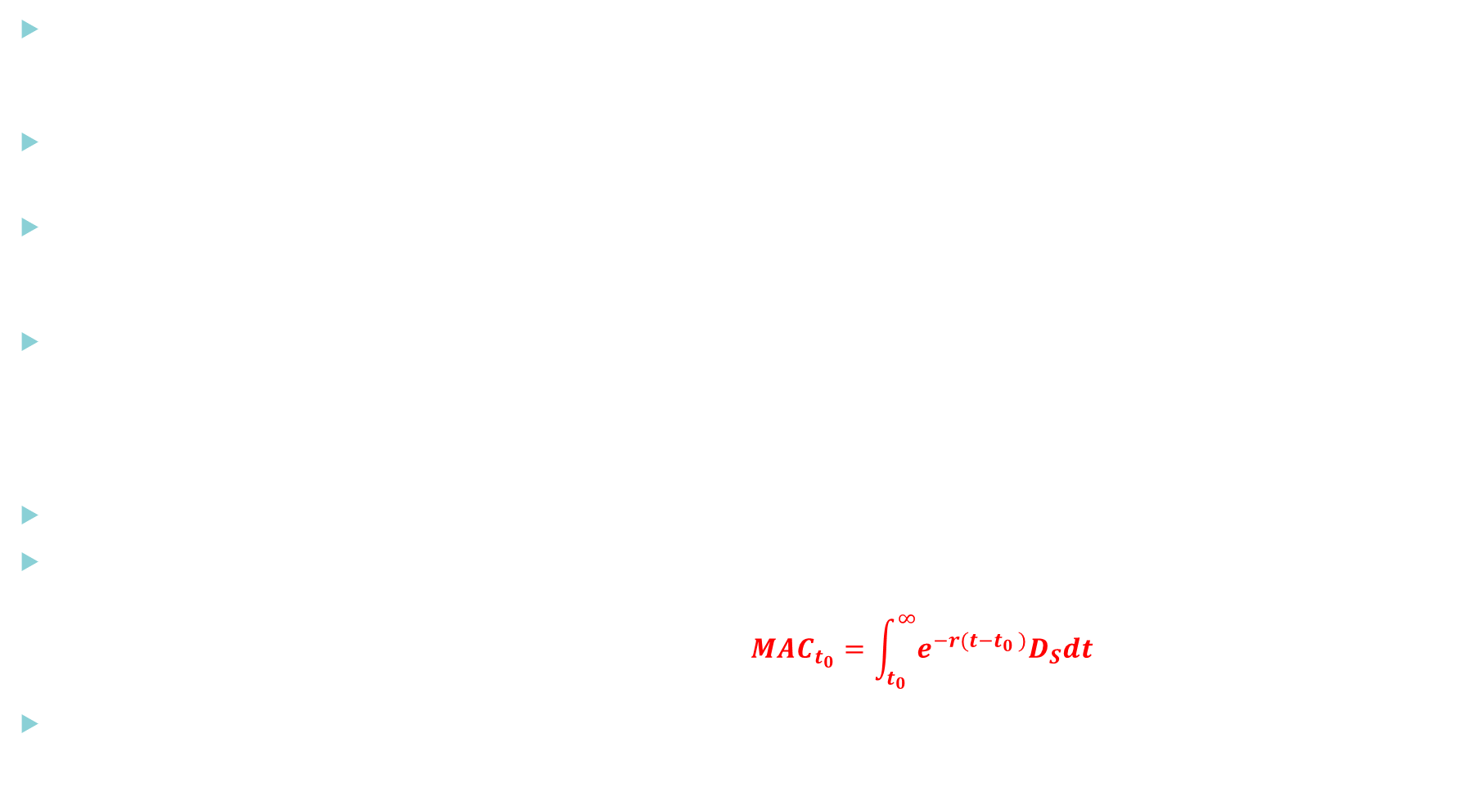
MAC=SCC
The costate equation is $\dot{μ}=rμ+D_{S}$. Considering $D_{S}$ as a function of time, this is a linear differential equation of the form $\dot{x}=ax+f(t)$. This can be solved with a good guess (not with separation of variables). Switching to a present value shadow price will be our ‘good guess’.
Define $λ=μe^{−rt}⇔\dot{λ}=\dot{μ}e^{−rt}+μe^{−rt}\left(−r\right)$. Multiply by $e^{rt}$ and plug into our costate equation gives
$$\dot{λ}e^{rt}=D_{S}$$
Integrate the costate equation using separation of variables and considering $DS$ as a function of time
$$dλ=e^{−rt}D_{S}dt$$
Integrate between time t₀ and infinity
$$\underset{λ_{∞}−λ_{t_{0}}}{\underbrace{\int_{λ_{t_{0}}}^{λ_{∞}}{dλ }}}=\underset{SCC_{t_{0}}}{\underbrace{\int_{t_{0}}^{∞}{e^{−rt}D_{S}dt}}}$$
The transversality condition is$λ_{∞}= 0$ (there is no non-negativity constraint on S)
Using the FOC $−λ_{t_{0}}= e^{−rt_{0}}\underset{MAC_{t_{0}}}{\underbrace{B_{E}}}$we have
$$e^{−rt_{0}}MAC_{t_{0}}=\int_{t_{0}}^{∞}{e^{−rt}D_{S}dt}⇔MAC_{t_{0}}=\int_{t_{0}}^{∞}{e^{−r(t−t_{0} )}D_{S}dt}$$
Since we do not know the time path of the drivers of $D_{S}$, this equation only gives intuition, not a closed form solution.

Slide 28
A closed form climate model
Dietz & Venmans 2019

Slide 29

Consumption function
Assume that consumption per capita is
$$c_{t}=\underset{\begin{aligned}consumption at t_{0} \\ at zero emissions \\ without damages\end{aligned}}{\underbrace{\tilde{c}}}∗\underset{\begin{aligned}exogenous \\ growth\end{aligned}}{\underbrace{e^{gt}}}∗\underset{\begin{aligned}Abatement cost \\ factor\end{aligned}}{\underbrace{e^{φE−\frac{φ}{2}E^{2}}}}∗\underset{\begin{aligned}Climate damage \\ factor\end{aligned}}{\underbrace{e^{−\frac{γ}{2}T^{2}}}}$$
We have a quadratic damage function
$$e^{−\frac{γ}{2}T^{2}}=e^{−\frac{γ}{2}ζ^{2}S^{2}}$$
The derivative of c with respect to temperature is$c_{T}=−c γT$ and $c_{S}=−cγζ^{2}S$
Abatement factor implies linear marginal abatement costs (which is equal to the marginal productivity of emissions)
$$c_{E}=c\left(φ−φE\right)$$
Business as usual emissions are defined by zero MAC: $c_{E}=0⇔E_{BAU}=\frac{φ}{φ}$

Slide 30
Mean of scenarios in 5th IPCC
Total abatement in central estimate is 0,12%*40/2=2,4% of world GDP

Slide 31

Welfare function
CES Utility per capita
$$u=\frac{c^{1−η}}{1−η}$$
Population is normalized at one and grows at constant rate n
$$L_{t}=e^{nt}$$
Welfare function using pure time preference rate $\tilde{δ}$
$$V\left(t,S\right)=\int_{t}^{∞}{e^{−(\tilde{δ}−n)\left(τ−t\right)} u(c) dτ}$$
Remark: In what follows I use the population-adjusted discount rate $δ=\tilde{δ}−n$
Remark2: the presence of an exogenous growth rate makes the value function dependent of time. We will avoid that when we code the problem by using capital per unit of productive labour $\left(\frac{k}{Le^{gt}}\right)$ by including this growth rate in the discount rate.

Slide 32

Solution
Bellman equation
$$δV(t,S)=\max_{E}{\{u\left(c\left(t,E,S\right)\right)+\underset{\frac{∂V}{∂t}+V_{S}E}{\underbrace{\dot{V}(t,S)}}\}}$$
First Order Condition for maximum
$$u_{c}c_{E}=−V_{S} (1)$$
Envelope theorem
$$δV_{S}=u_{c}c_{S}+\dot{V_{S}} (2)$$
Take time derivative of (1) and substitute out $\dot{V_{S}}$ in (2) to find the Euler equation
$$δu_{c}c_{E}=−u_{c}c_{S}+\dot{u_{c}}c_{E}+u_{c}{\dot{c}}_{E}$$
Using $c_{E}=c\left(φ−φE\right)$ and $c_{S}=cγζ^{2}S$ and divide by $u_{c}c$
$$φ\dot{E}+\left(δ−\frac{{\dot{u}}_{c}}{u_{c}}−\frac{\dot{c}}{c}\right)\left(φ−φE\right)−γζ^{2}S=0$$
With $\dot{u_{c}}/u_{c}=η \dot{c}/c$ (Ramsey rule).
Assuming that the growth rate of consumption is constant at $\tilde{g}$ (slightly lower than g) we obtain a linear second order differential equation with a closed form solution.
$$\ddot{S}−\left(r−\tilde{g}\right)\dot{S}−γζ^{2}S+\frac{\left(r−\tilde{g}\right)φ}{φ}=0$$
Steady state warming $T^{∗}=\frac{\left(r−\tilde{g}\right)φ}{γζ}$

Slide 33
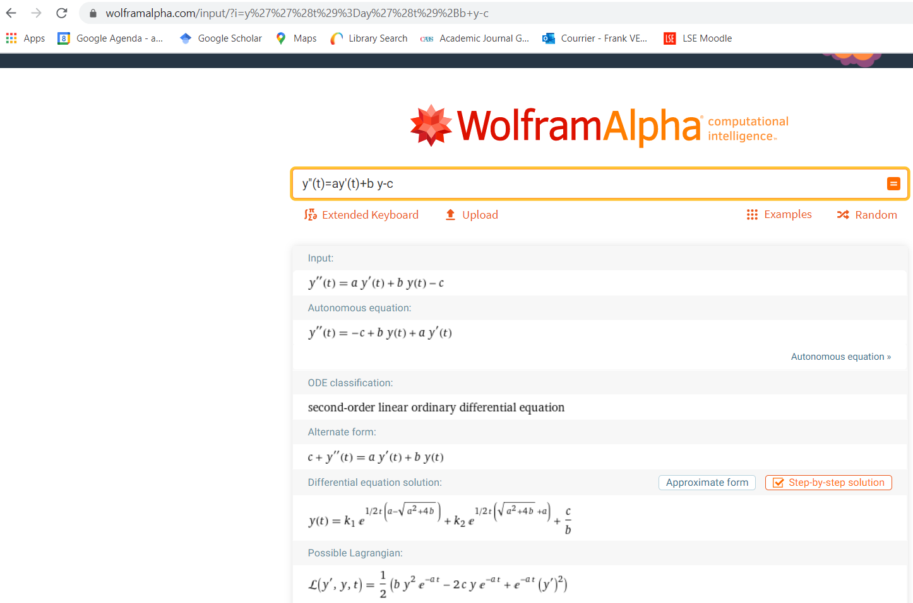

Slide 34
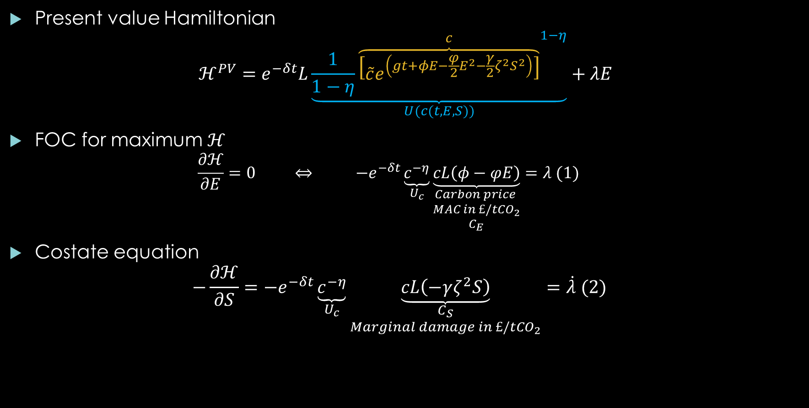
Same solution with optimal control
Present value Hamiltonian
$$ℋ^{PV}=e^{−δt}L\underset{U(c(t,E,S))}{\underbrace{\frac{1}{1−η}{\overset{c}{\overbrace{\left[\tilde{c}e^{\left(gt+φE−\frac{φ}{2}E^{2}−\frac{γ}{2}ζ^{2}S^{2}\right)}\right]}}}^{1−η}}}+λE$$
FOC for maximum $ℋ$
$$\frac{∂ℋ}{∂E}=0 ⇔ −e^{−δt}\underset{U_{c}}{\underbrace{c^{−η}}}\underset{\begin{aligned}Carbon price \\ MAC in £/tCO_{2} \\ C_{E}\end{aligned}}{\underbrace{cL\left(φ−φE\right)}}=λ (1)$$
Costate equation
$$−\frac{∂ℋ}{∂S}=−e^{−δt}\underset{U_{c}}{\underbrace{c^{−η}}}\underset{\begin{aligned}C_{S} \\ Marginal damage in £/tCO_{2}\end{aligned}}{\underbrace{cL\left(−γζ^{2}S\right)}}=\dot{λ} (2)$$
Notes:
Remark: you can also work with a CV Hamiltonian and use ‘discount rate’ $δ−n+\left(η−1\right)g :$
$$ℋ^{CV}=\frac{L_{0}c_{0}^{1−η}}{1−η}\exp\left(\left(1−η\right)\left(φE−\frac{φ}{2}E^{2}−\frac{γ}{2}ξ^{2}S^{2}\right)\right)$$

Slide 35
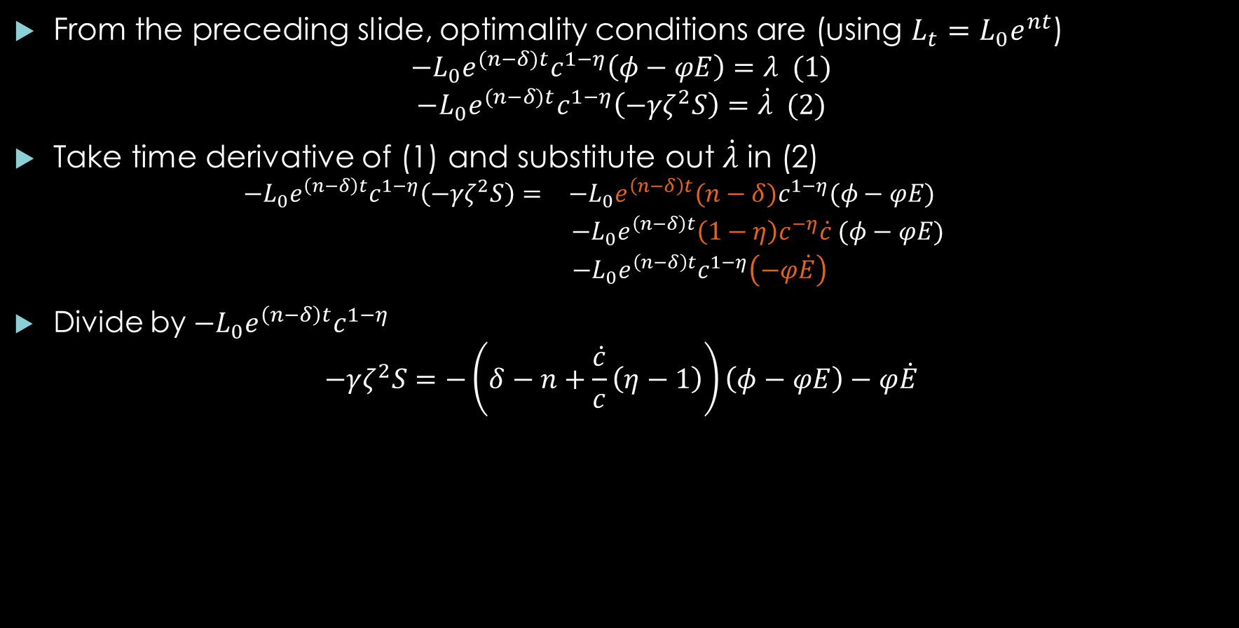
Euler equation
From the preceding slide, optimality conditions are (using $L_{t}=L_{0}e^{nt}$)
$$−L_{0}e^{(n−δ)t}c^{1−η}\left(φ−φE\right)=λ (1)$$
$$−L_{0}e^{(n−δ)t}c^{1−η}\left(−γζ^{2}S\right)=\dot{λ} (2)$$
Take time derivative of (1) and substitute out $\dot{λ}$ in (2)
$$\begin{matrix}−L_{0}e^{\left(n−δ\right)t}c^{1−η}\left(−γζ^{2}S\right)= & −L_{0}e^{\left(n−δ\right)t}(n−δ)c^{1−η}(φ−φE) \\ & −L_{0}e^{\left(n−δ\right)t}\left(1−η\right)c^{−η}\dot{c} (φ−φE) \\ & −L_{0}e^{\left(n−δ\right)t}c^{1−η}\left(−φ\dot{E}\right) \end{matrix}$$
Divide by $−L_{0}e^{\left(n−δ\right)t}c^{1−η}$
$$−γζ^{2}S=−\left(δ−n+\frac{\dot{c}}{c}\left(η−1\right)\right)\left(φ−φE\right)−φ\dot{E}$$

Slide 36

Solve Euler equation
Assume $\frac{\dot{c}}{c}≅g−0,02\%≝\tilde{g}$ constant, i.e. 0,02% slower than g due to increasing abatement costs in the first decades and increasing climate damages in the later decades.
$r=δ−n+η\tilde{g}$ is the consumption discount rate (population growth increases the weight on the future) and rearrange.
$$\dot{E}=\underset{a}{\underbrace{\left(r−\tilde{g}\right)}}E+\underset{b}{\underbrace{\frac{ζ^{2}γ}{φ}}}S−\underset{c}{\underbrace{\frac{\left(r−\tilde{g}\right)φ}{φ}}} (3)$$
Together with the equation of motion $\dot{S}=E$, we have a linear system of 2 differential equations, which can be solved. Fortunately, it has an analytical solution, which we can find on the internet (Matlab can also do this).
For notational ease we can write this system as a single second order differential equation.
$$\ddot{S}=a\dot{S}+bS−c$$

Slide 37

Solution
We need to find k₁ and k₂ using initial and terminal conditions.
If k₂ is different from zero, we get infinite warming or cooling in the steady state => k₂=0
k₁ can be found using the initial stock of cumulative emissions $S\left(t_{0}\right)=S^{0}$
Solution is therefore
$$S_{t}=\left(S^{0}−\frac{c}{b}\right)\exp\left(\frac{1}{2}t\left(a−\sqrt{a^{2}+4b}\right)\right)+\frac{c}{b} (4)$$
The time derivative of this equation gives a solution for emissions.
The carbon price corresponds to marginal abatement costs expressed in euros
$$p=Lc (φ−φE)$$
Steady state: use $\dot{E}=0;\dot{S}=E=0$ in equation 3 or $t=∞$ in equation 4
$$T^{∗}=ζS^{∗} =\left(r−\tilde{g}\right)\frac{φ}{ζγ}$$

Slide 38
Parameters

Slide 40


Solve the model in excel
$$\max_{E_{2020},E_{2025},E_{2030},….}\sum_{t=2020}^{2400}{e^{−δt}u(c)} s.t. E_{t>2200}=0$$
Long horizon is necessary to include long term effects.
The unconstrained model has positive emissions close to 2300.
Impose zero emissions by not including them in the optimization.
Install the excel solver. https://www.ablebits.com/office-addins-blog/2016/06/22/how-to-use-solver-in-excel-with-examples/#how-to-use-solver-in-excel
DICE in GAMS is solved this way.
Fmincon function in Malab does the same.
Notes:
https://www.ablebits.com/office-addins-blog/2016/06/22/how-to-use-solver-in-excel-with-examples/#how-to-use-solver-in-excel

Slide 41
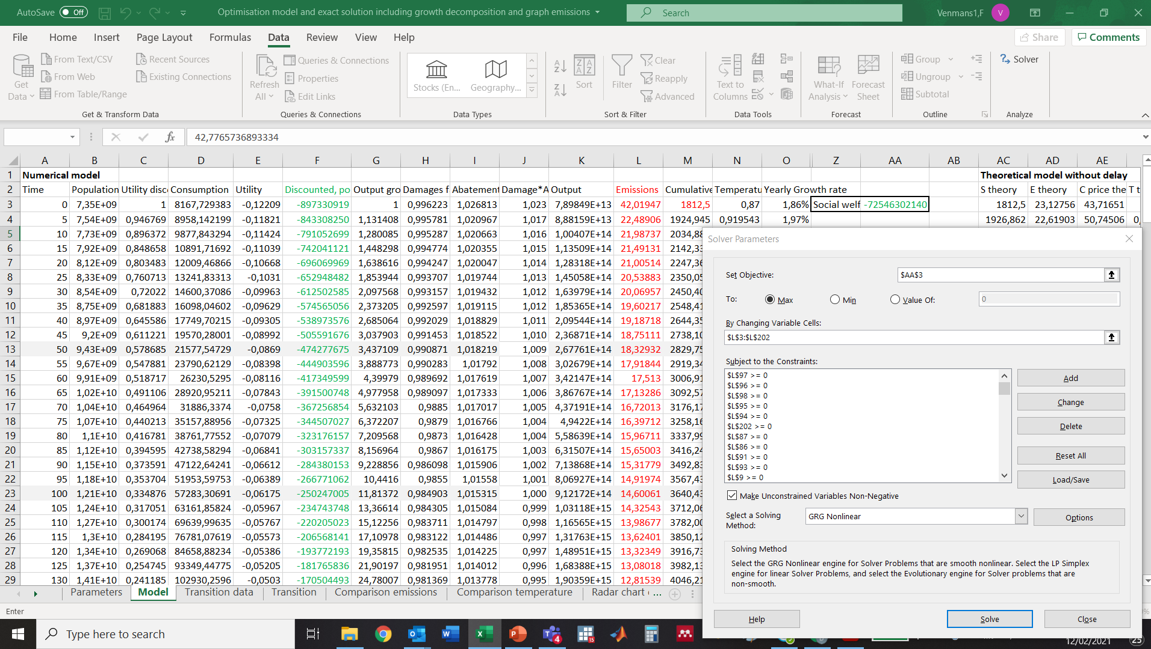
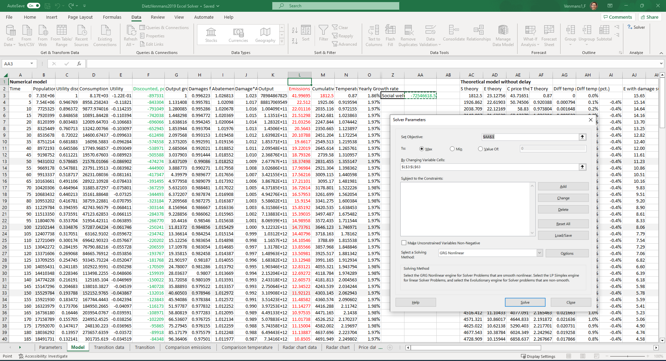

Slide 42
Non optimal paths and open loop models

Slide 43

SCC on non-optimal paths
What is the likely discounted damage of a tonne of CO2 emitted today?
Since we are unlikely to be on an optimal path, the SCC is much higher.
Calculating this can be done developing n scenarios with weight $w_{i}$
$$SCC=\frac{1}{u_{c_{0}}}\sum_{t=2020}^{2400}{\sum_{i=0}^{n}{w_{i}e^{−δt}u_{c_{t,i}}}D_{T_{t,i}}}$$
With marginal damages $D_{T}=cγT$
The correlation between marginal utility and damages is the called the climate beta
For likelihoods of future temperatures seeVenmans Carr 2023 https://www.lse.ac.uk/granthaminstitute/publication/the-unconditional-probability-distribution-of-future-emissions-and-temperatures/
Nordhaus (2017) projections and uncertainties about
climate change in an era of minimal climate policies,
NBER working paper
Discount rate | Social cost of carbon €/tCO2
2,5 % | 127
3 % | 80
4 % | 40
5 % | 20

Slide 44

Open loop risk model
$$\max_{E_{2020},E_{2025},E_{2030},….}\sum_{t=2020}^{2300}{e^{−δt}𝔼u(c)} s.t. E_{t>2200}=0$$
Expectation is taken over different parameter values, for example the damage parameter
Can be solved again in excel in a similar way.
It assumes no ‘learning’, it assumes that social planner fixes an emission trajectory today and sticks to that trajectory, even if he learns that damages are larger or lower than anticipated.
We will now switch to the closed loop model, or recursive model, where the social planner optimally adjusts to the stochastic realizations of the preceding period.

Slide 45
Recursive models with many state variables and uncertainty

Slide 46

Add capital and a shock on temperature
2 states: cumulative emissions S and kapital K
$$K_{t+1}=\left(1−decay\right)K_{t}+I$$
$$S_{t+1}=E_{t}+S_{t}+\underset{shock\sim N(0,σ)}{\underbrace{e}}$$
2 decision variables: emissions E and investment I
Aggregate consumption
$$C=\underset{Production}{\underbrace{A_{0}e^{\left(1−α\right)gt}L^{1−α}K^{α}e^{φE−\frac{φ}{2}E^{2}−\frac{γζ^{2}}{2}S^{2}}}}−I$$
To avoid the value function to depend on t and to assure a steady state, we write the model in terms of capital, investment and consumption per unit of effective labour, for example $k=\frac{K}{Le^{gt}}$, with g the exogenous rate of labour-saving productivity growth. This will also give us a larger discount rate, helpful for convergence.
$$c=\underset{Production}{\underbrace{A_{0}k^{α}e^{φE−\frac{φ}{2}E^{2}−\frac{γζ^{2}}{2}S^{2}}}}−i$$
Value function $V_{0}=\int_{0}^{∞}{e^{−δt}L_{0}e^{nt}\frac{{\left(C/L\right)}^{1−η}}{η−1}}=\int_{0}^{∞}{e^{−\overset{r}{\overbrace{(δ−n+\left(η−1\right)g)}}t}L_{0}\frac{c^{1−η}}{η−1}}$
Bellman equation in discrete time
$$V(S_{t},k_{t} )=\max_{E,i}{\{u\left(c\right)+e^{−rt}𝔼[V (S_{t+1},k_{t+1})]\}}$$
Notes:
Equation of motion for capital becomes $k_{t+1}=\left(1−decay−g\right)k_{t}$

Slide 47

Value function iteration
Make a grid of points, spanning the domain of k and S (including initial values and steady state)
Approximate the value function by a polynomial
$$V\left(S,k\right)=a+bS+cS^{2}+dk+ek^{2}+fSk+gSk^{2}+hS^{2}k+iS^{2}k^{2}$$
The example will use a polynomial to the power 6 for both dimensions, giving 36 coefficients. This can be fit exactly through a grid with 36 points. A Chebyshev polynomial is slightly different, you should think of it as a sum of cosinus functions with different frequency.
Compecon also supports linear interpolation and splines. Another extension is neural nets (Scheidegger et al.)
Algorithm:
1. Start with a guess for the value function on each point of the grid (for example by using a linear quadratic approximation of the model). The guess corresponds to a set of parameters (abcdefghi) in the polynomial.
2. Calculate the Right Hand Side of Bellman equation (maximizing over $E,i$ on each point of the grid)
$$V(S_{t},k_{t} )=\max_{E,i}{\{\underset{function of S_{t},k_{t},E_{t} ,i_{t}}{\underbrace{u\left(c\right)}}+e^{−rt}𝔼[V (\underset{function of S_{t},k_{t},E_{t} ,i_{t}}{\underbrace{S_{t+1},k_{t+1}}})]\}}$$
3. Update the value function (new parameters)
4. Go back to 2, unless error is small.
The maximized emission and investment on each point of the grid is the policy function (a value on each node of the grid, not a polynomial). If you update the policy function only every n steps, it is called Optimistic Policy Iteration. Faster, not always more stable.
Also possible to iterate over the policy function (Howard policy iteration aka Newton)

Slide 48
Compecon toolbox
Write function with 3 types of output
Case 'b’:
Out1=lower bounds on decision
Out2=upper bounds on decision
Case 'f'
Out1=utility
Out2=first derivatives wrt decision
Out3=second derivatives wrt decision
Case 'g'
Out1=equations of motion (one per row (check))
Out2=first derivatives wrt decision
Out3=second derivatives wrt decision

Slide 49
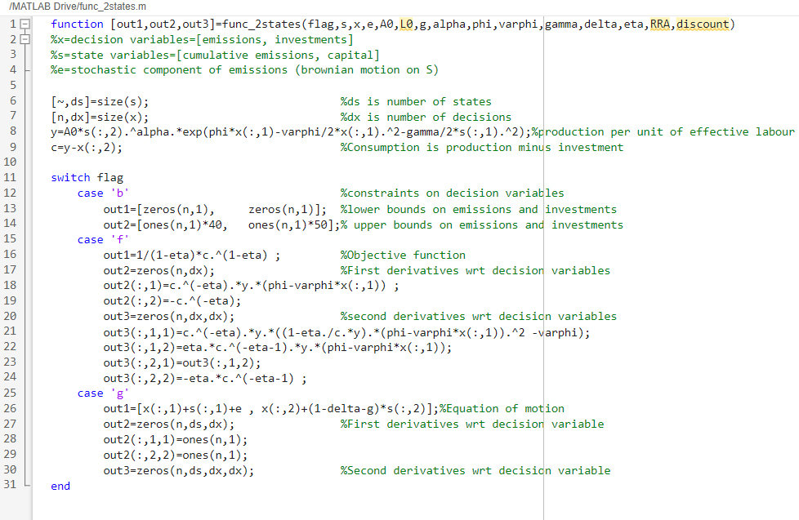

Slide 50
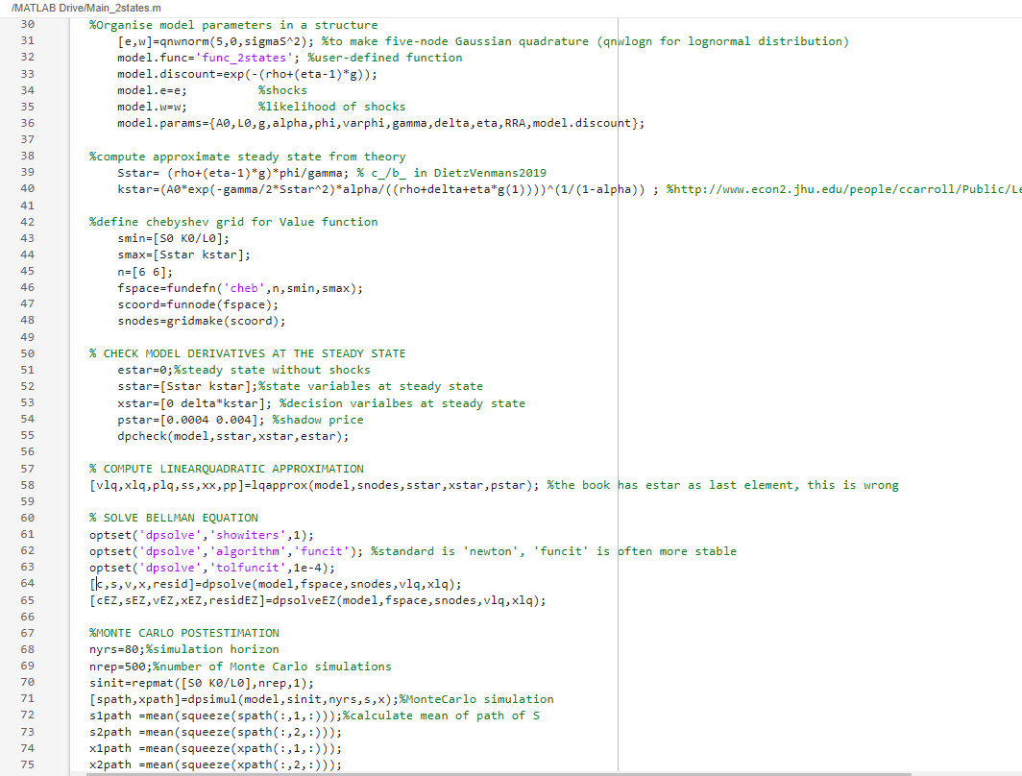

Slide 51
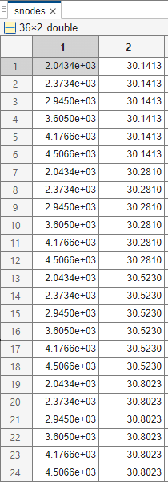
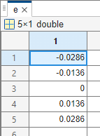
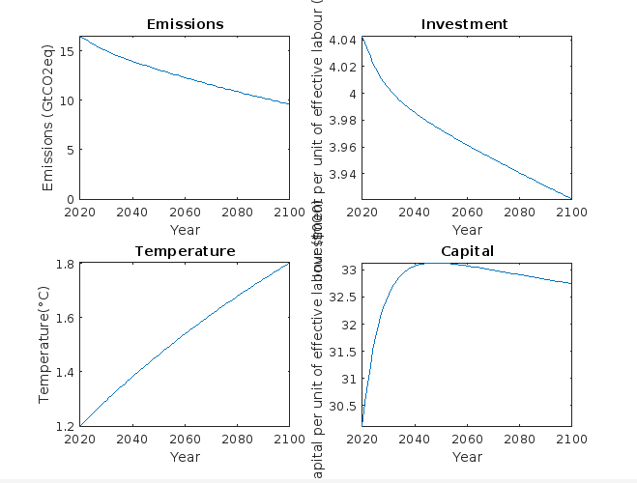
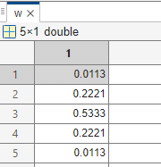
Matrices and results

Slide 52
Tips
Toolkit is available at https://github.com/PaulFackler/CompEcon
The toolkit is explained in Fackler & Miranda’s , https://mitpress.mit.edu/9780262633093/applied-computational-economics-and-finance/
I made a few extensions
dpsolveEZ: solves for Epstein-zin preferences
dpsolveFV and dpsolveEZFV:
allows for complete polynomials (leaving out the terms with highest sum of powers and using a least square fit to the grid instead of an exact fit)
Allows to use Optimistic Policy Function iteration, (but does not converge easier)
Allows to switch from funcit to newton when the error is sufficiently small
Finding a good initial solution is key. Non-convergence is a very common problem. Start with a simpler model and use this solution as the initial guess for the more complicated solution. Take 10 intermediary models if needed.
Be careful with shocks (especially jumps) that bring the state variable at time t+1 outside the grid. This is a common reason why

Slide 53
Neural networks
Instead of using a polynomial, use a neural net.
Estimate the Policy function (decisions as a function of states) instead of Value function
Instead of minimizing errors of the Bellman equation, minimize errors of
First Order Conditions for maximizing the Bellman equation
Euler equation combined with the equation of motion
Instead of finding the solution to a fixed grid, sample randomly on the grid
Work in Python, tensorflow (keras)
Azinovic, M., Gaegauf, L., & Scheidegger, S. (2022). Deep equilibrium nets. International Economic Review, 63(4), 1471–1525. https://doi.org/10.1111/iere.12575
Friedl, A., Kubler, F., Scheidegger, S., & Usui, T. (2023). Deep Uncertainty Quantification : With an Application to Integrated Assessment Models. Working Paper.
Folini, D., Kubler, F., Malova, A., & Scheidegger, S. (2023). The climate in climate economics. SSRN Electronic Journal, 1–52. https://doi.org/10.2139/ssrn.3885021

Slide 54
Insights from models under uncertainty

Slide 55
Parameter sensitivity of DICE

Slide 56
DICE (Nordhaus, 2016)
Dice has a very similar structure as the model in Dietz&Venmans 2019.
The main differences are:
Not only emissions but also savings are optimized. Capital is input in a Cobb-Douglas production function.
Carbon intensity of the economy is exogenously decreasing over time. This creates an incentive to postpone abatement.
Marginal abatement cost function is convex (not linear)
Damage function is very similar in shape, but ‘low damages’ in Dietz&Venmans correspond to the central estimate in DICE.
The climate module of the 2016 model has a delay of 50 years between emissions and peak warming, this has been corrected in the latest model.

Slide 57
Hänsel et al. (2020): Updating DICE
EBM=energy balance model: delay between forcing and warming.

Slide 58
Hänsel et al. (2020)
EBM=Energy Balance Model.

Slide 59
Hänsel et al.
Carbon prices in 2020
Original Dice 40$/tCO2
Updated DICE with r=5%. 82$/tCO2
Run updated DICE 184 times with different discount rates of experts and take mean of the price in 2015: 101$/tCO2
Run updated DICE once with r=2,5% (mean discount rate of experts): 208$/tCO2

Slide 60
Tipping points

Slide 62
Lenton et al. Tipping elements in the Earth’s climate system PNAS (expert elicitation)

Slide 63

Cai & Lontzek JPE 2018
Add stochastics to the DICE model
1 tipping point which will create damages of 2.5%, 5% or 7.5% of GDP forever.
Once the tipping point is crossed, the damages come in uncertain steps, with their full effect after 50 years.
Warmer temperatures increase the probability of crossing a tipping point.
Epstein-zin preferences with
elasticity of marginal utility $η=0.66$
relative risk aversion of 10.
The economy is subject to economic cycles, fitted on US GDP.
Risk-adjusted discount rate for damages is 2,4%.
They compare this with DICE, with updated climate dynamics

Slide 64

Cai & Lontzek 2018
DICE with $η=\frac{1}{ψ}=2$ =>SCC=10$/tCO2
DICE with $η=\frac{1}{1,5}=0,66$=> SCC=25$/tCO2
Average carbon price starts at 124$/tC=34$/tCO2
Average carbon price in 2100=120$/tCO2
Carbon price is larger mainly because the tipping point increases the expected damages.
The effect of risk aversion is small

Slide 65
Stranded assets

Slide 66
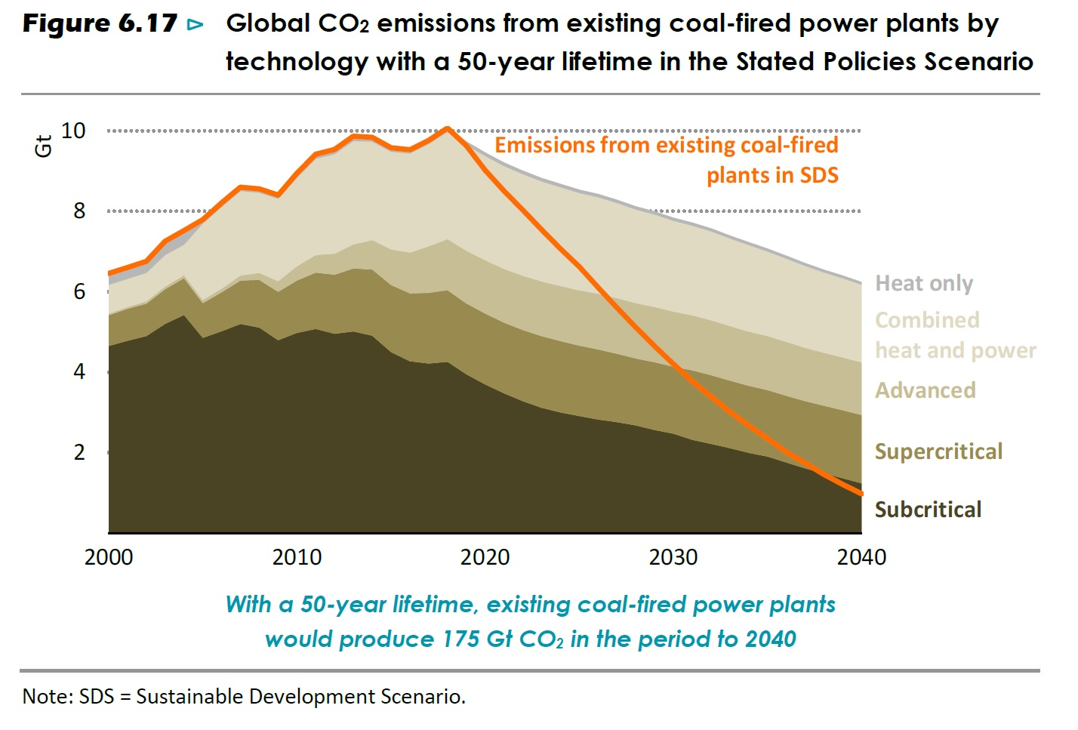
IEA Energy Outlook 2020

Slide 67
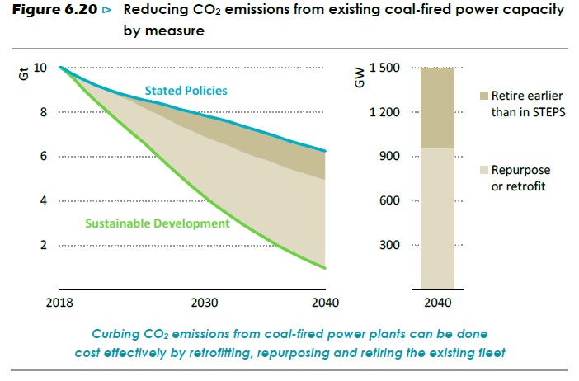
IEA, world Energy Outlook 2019

Slide 68

Optimal emissions with asset stranding
Campiglio, Dietz, Venmans 2022
Assume that emissions are the result of dirty capital
If you want to abate at a speed beyond 5,5% i.e. the decay rate of capital + the decrease of carbon intensity of dirty capital you have repurposing/stranding costs.
Repurposing/stranding costs are quadratic.
Some repurposing opportunities are cheap (burn pellets instead of coal)
At very fast abatement, some assets lose 100% of their value.
At very fast abatement, there are wider adjustment costs
We have multiple climate disasters, which increase damages by 15%.
Epstein-Zin preferences $η=1,35;RRA=4$

Slide 69

Technology improvement
Exogenous learning:
Example:
energy efficiency tends to improve without climate policy.
Artificial intelligence will develop without climate policy, but it will improve smart grids.
This reduces the long-term abatement cost
=> It reduces the choke price in a cost-effectiveness analysis
=> It reduces the optimal peak warming in a cost-benefit.
Although the carbon price growth rate is merely affected, it starts lower.
Endogenous learning:
Example: learning by doing, photovoltaics become cheaper with higher cumulative installed capacity. Climate policy is necessary for endogenous learning.
Postponing emissions (higher S) postpones marginal damages but also expedites technological learning. Both effects have the same sign, both flattening the carbon price path=> carbon price is higher at the start (under most conditions).
$$\underset{oppotunity cost of waiting}{\underbrace{r}}=\underset{increasing marginal abatement costs}{\underbrace{\frac{\dot{C_{E}}}{C_{E}}}}+\underset{\begin{aligned}avoided climate damage \\ & &Learning by doing\end{aligned}}{\underbrace{\frac{{−C}_{S}}{C_{E}}}}$$
Notes:
At some point cooling the earth passes the cost-benefit test. Steady state below peak warming.

Slide 70
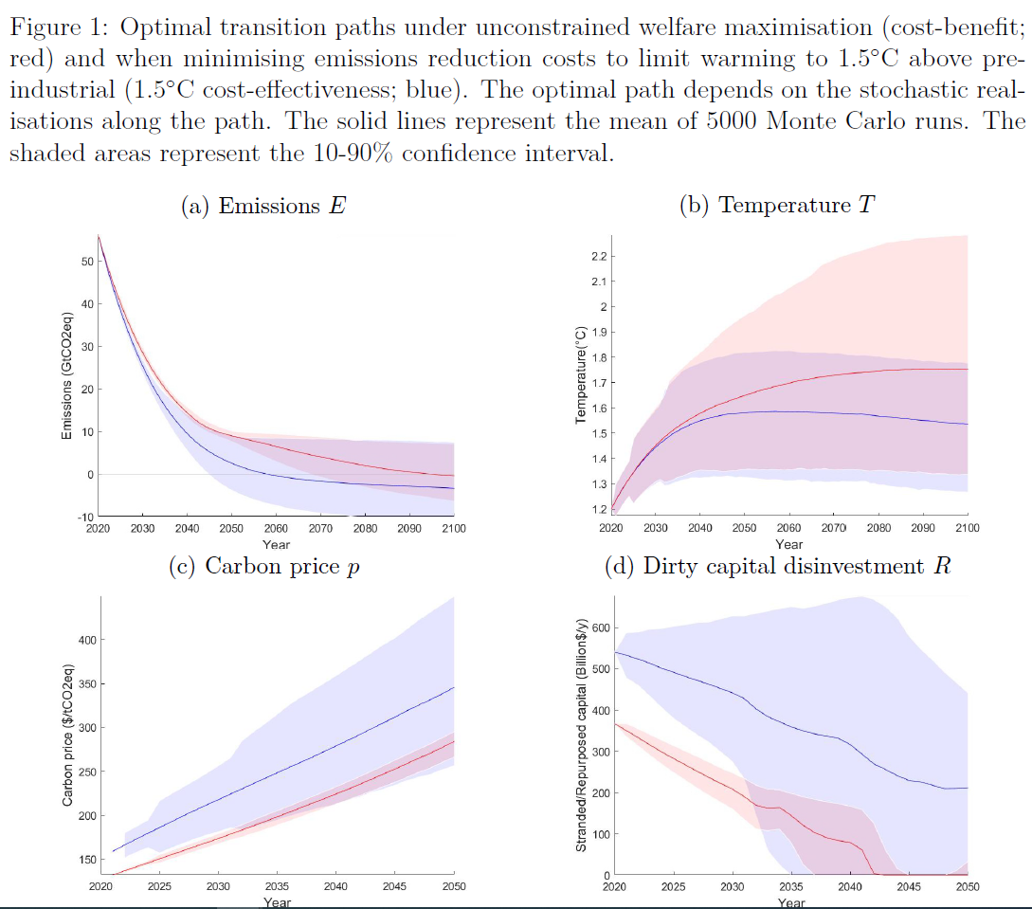

Slide 71
The green paradox & stranded fossil reserves

Slide 72
Green paradox: a red herring?
Sinn (2008) develops a model in which climate policy cannot avoid the total stock of fossil fuels to be burnt (extraction costs + tax<the choke price at any time)
As a result, by assumption, climate policy is incapable of decreasing the long-term warming of the earth.
This model predicts earlier extraction for any policy that reduces the net present value of future rents relative to current rents.
Cheaper green technology
Energy efficiency improvements
A rapidly increasing tax
The anticipation of a future tax
Anticipation of climate policy will most likely lead to the opposite effect due to lower fossil consumption due to opposite effects
An anticipation of strict climate policy leads to divestment: less exploration and investment in new wells less investment in fossil fuel consuming infrastructure
An anticipation of strict climate policy leads to R&D reducing the future choke price.
The essence of climate policy is to keep fossil fuels in the ground, i.e. ensure that extraction costs+tax > choke price.

Slide 74
Unburnable reserves

Slide 75

Policy makers should anticipate cheap fossil fuels
The current price of fossil fuels indicates that markets do not believe the Paris agreement.
If a 2°C world becomes a credible future, oil will not be scarce, rents will collapse, and oil will be sold at the extraction costs of easily accessible fossil fuel (around 20 to 30$/barrel).
The terminal condition at zero emissions is
$$Marginal Abatement Cost=Carbon Price=choke price−\underset{extraction costs }{\underbrace{fossil price}}$$
The choke price is the marginal productivity of oil at zero consumption, determined by technology costs
If modellers assume a constant or increasing fossil fuels price, they underestimate the carbon price.
In a cap-and-trade system, the carbon price adapts automatically to the fossil fuel price. Some carbon or fuel taxes increase automatically when fossil prices decrease (ex Belgium).
In a cost-benefit setting, rents are a transfer, not a societal cost. Optimal emissions paths and optimal warming should not be affected.
Yet, the collapse of the fossil fuel rents can affect coalition building:
A few large losers (fossil fuel producers)
A large group of fossil importers, for whom fossil rents are substituted by carbon price incomes.

Slide 76
Conclusion
There is no consensus on the right social cost of carbon. Many estimates are in the range of 30-120$/tCO2
The major determinants are
Discount rate
Damage function
Future marginal abatement costs
The social cost of carbon/Marginal abatement cost today increases with
A fast reaction of the climate system to emissions
Climate risk
Emissions inertia (stranded assets or repurposing costs)
Collapsing fossil fuel rents
Learning by doing
Non-optimal paths

